Slide 1
Real Time Videocam Smart Attendance Using Tensorflow

Slide 2
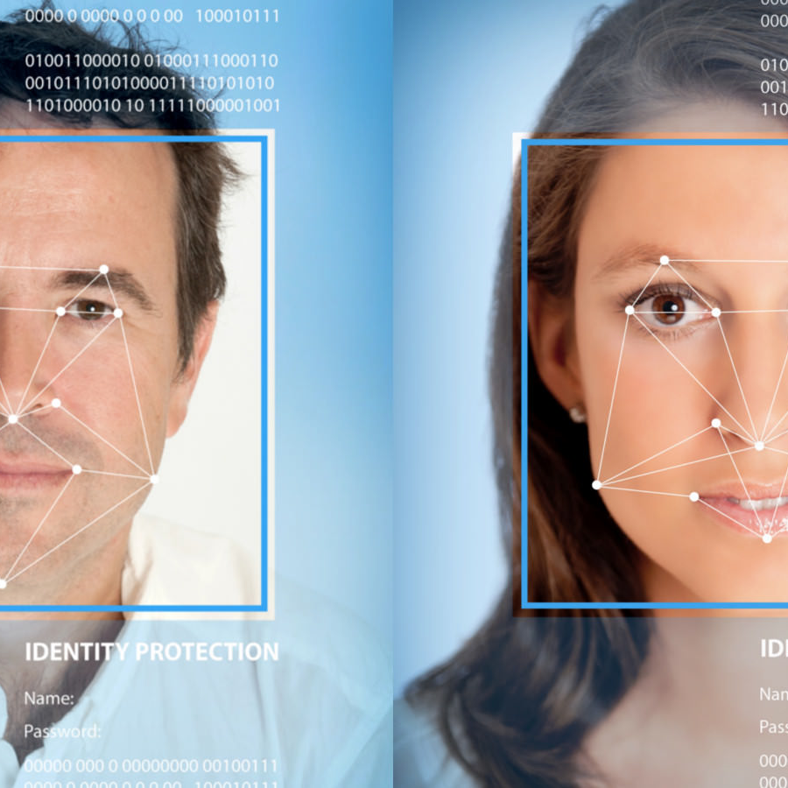
LET’s BEGIN NOW
Project Description
Real Time Videocam Smart Attendance Using Tensorflow
The project that will be created implements the Deep Learning method using the Convolutional Neural Network which is implemented using Tensor Flow to recognize human face patterns. The program created will use the Python programming language to perform various processes. The process that will be carried out in the program includes the formation of a modeling system introducing patterns, conducting training to be able to recognize faces using a data set from a collection of human face photos that will be targeted for recording attendance automatically, as well as testing processes in realtime testing automatic.

Slide 3
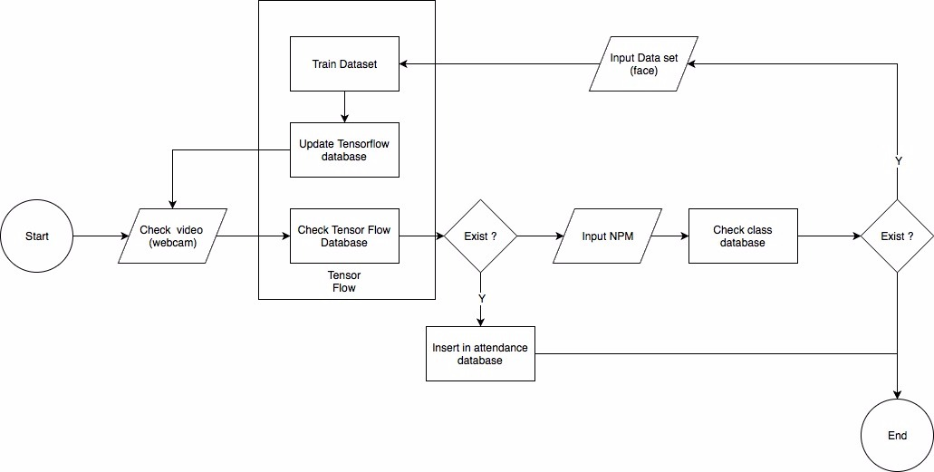
Flow Chart Plan

Slide 4
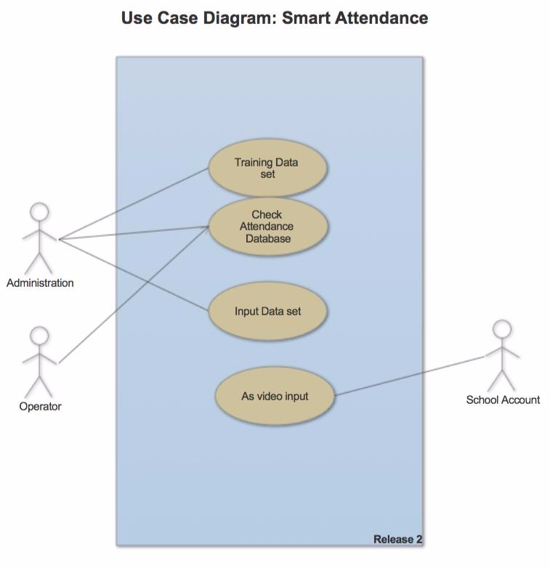
Flow Chart Plan

Slide 5





Outline Plan
Real Time Videocam Smart Attendance Using Tensorflow
I
II
III
IV
V
Basic Theory
Design
Source Code
Implemention
User Guide

Slide 6




Timeline Plan
November 1st - 2nd Week
November 3rd - 4thWeek
Study the technology used
Install the necessary environment
Make a system design plan
Arrange source code based on the design that has been planned
Produce products in the form of project prototypes
December 1th
December 2nd
Compile reports
Test the system
Make various improvements
Finalize documentation
Make a project video

Slide 7
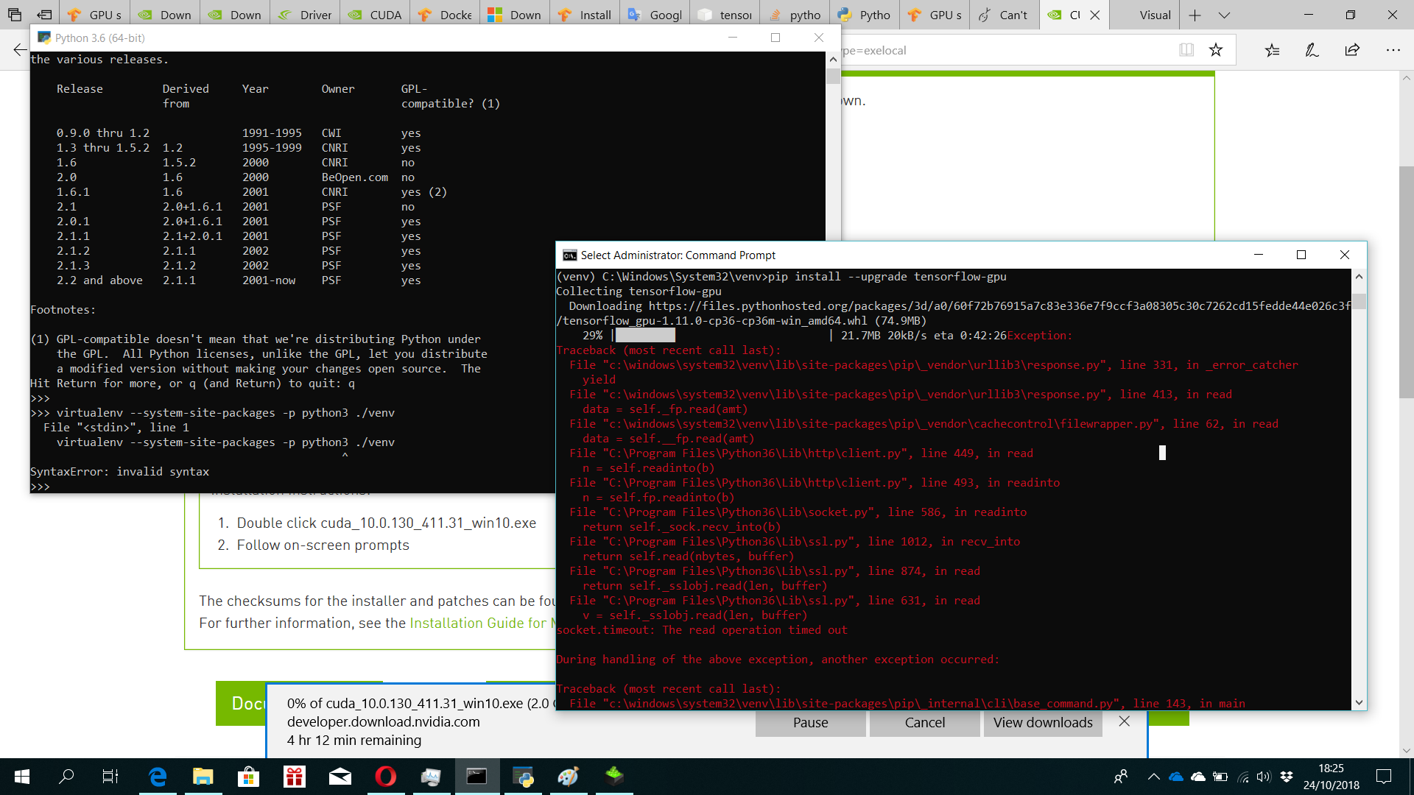

Slide 8
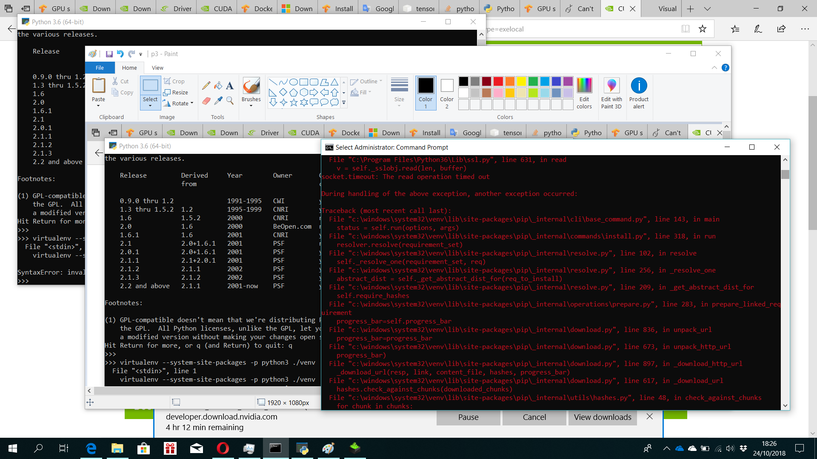

Slide 9
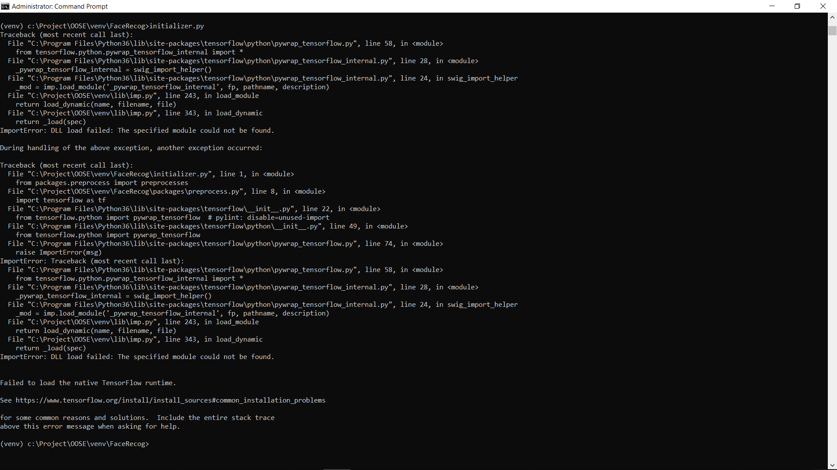

Slide 10
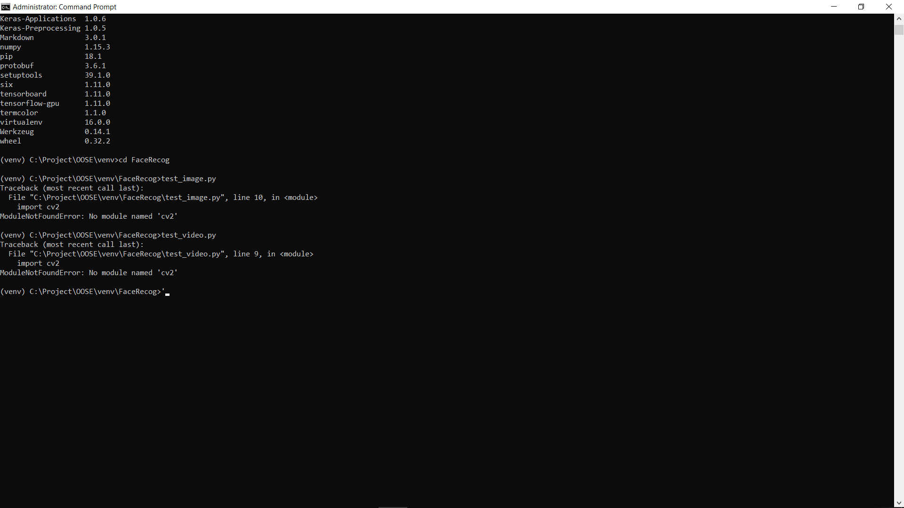

Slide 11
Thank you!

